Slide 1
Introduction to Business Planning
Notes:
This module should not cover the entire business plan or process to write it, but will concentrate on a few main pieces of the business
plan.
Mention to participants should not just use a boilerplate (language & template) and bring it to the bank. The business plan is a living document that can and should be retooled based
on the evolving decisions and strategies one plans to utilize

Slide 2
Objectives
Develop the basis for a business plan, understand how to move from a feasibility analysis to constructing a viable and fundable business plan. Additionally:
Identify the must-have sections and to focus them based on different types of stakeholder needs

Slide 3
Agenda
Approach to Business Planning
  Why?
  When?
  Contents & Tools
  Pitfalls

Slide 4
A few thoughts…..
“If you fail to plan, you plan to fail.”
  -Benjamin Franklin
“In preparing for battle I have always found that plans are useless, but planning is indispensable.”
  -Dwight Eisenhower
Notes:
Instructor Notes:
These are a couple of quotes to get them thinking. Relate them to business ownership and to the military. Just like you have a plan in the military, you have to have one as well in business or you are doomed to fail.

Slide 5
Why write a business plan?
Decision Making
  As an evaluation tool for making strategic choices
Communication!
  Necessary to get loans, investment, supplies, employees, etc.
Analysis!
  Thinking/finding critical areas before investing cash, time
Guide to action!
  How to do things, when and with what
  Taking insurmountable task into smaller, more manageable ones
Notes:
Instructor Notes:
Talk about the different reasons that we write business plans.
Communicating the plan is essential to a variety of different individuals (i.e.: investors for a return, suppliers or potential employees you may want to hire who are skeptical about working for a start-up).
Writing the plan will ensure that you have done the thinking and analysis necessary for you to mitigate as much risk as possible.
You have to have a guide to follow as you launch that business.
Make sure your business plan is a living and working document that changes with the business but holds you accountable and keeps you on track.

Slide 6
When to do it?
Before you get started
When you need money, “stuff” & people
As a regular part of running your business
Remember it is an on-going process, not a one-time event.
CAVEAT: All of the above depends on what you are doing, your goals, and what your needs are.
Notes:
Instructor Notes:
This is obviously not a one size fits all question. Focus on the importance of starting this now rather than the day you ‘open the door.’ By having a strong business plan when you launch, you can ensure that you will go back to it regularly to make changes and check on milestones. Start it now, rather than later!

Slide 7
What’s in the plan?
Your Concept
Industry Description
Market Analysis
Economics of the Business
Marketing Strategy
Operations
Management Team
Risk & Assumptions
Timeline
Financial Projections
Offering
Notes:
Instructor Notes:
Cover the big picture business plan and everything that is in it. Refer back to the lessons over the past two days and highlight how each of these parts fit into the larger business plan.

Slide 8
What’s in the plan?
Leverage the selected tools:
Lean Business Model Canvas
  https://www.strategyzer.com/canvas/business-model-canvas
Really Big Value Idea Sketchpad
  https://www.straightupbusiness.institute/courses/idea-maker/
Notes:
Instructor Notes:
Start plugging the follow-on courses and working with resource partners. This is a publication that is very practical and easy to use that they will receive when they enroll. It asks prompting questions to assist with writing the business plan.

Slide 9
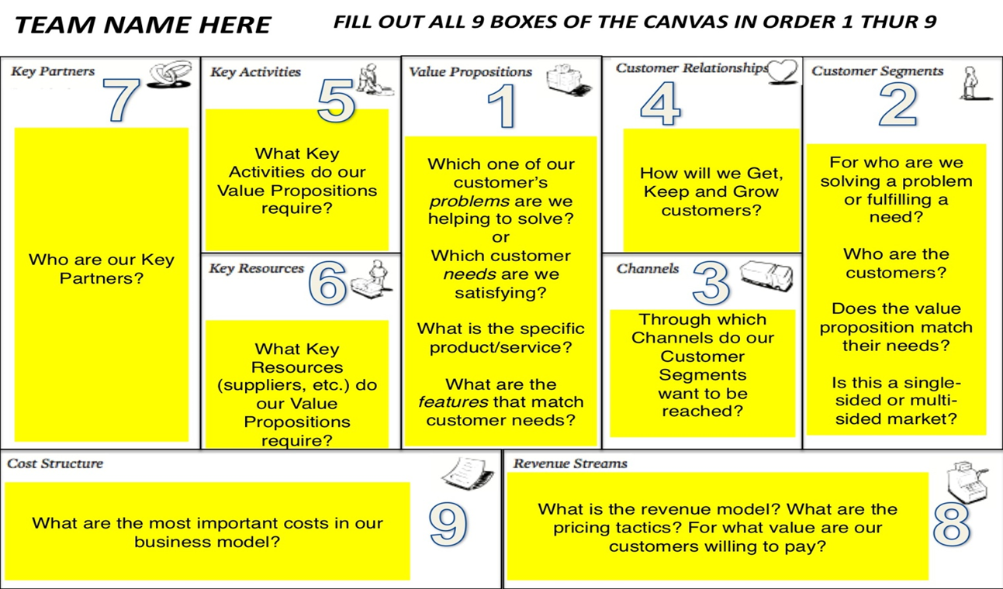
Resource: Business Model Canvas
Notes:
Background:
The Business Model Canvas is from enables both new and existing businesses to focus on operational as well as strategic management and marketing plan (it comes from Alexander Osterwalder’s book: The Business Model Generation)
It is a visual chart with elements describing a firm's or product's value proposition, infrastructure, customers, and finances. It can help firms align their activities by illustrating potential trade-offs.
Instructions:
Start with #1 in the middle (Value Proposition) and discuss each box with the class.
Use a company you are familiar with, or use an example like Uber from this module.
This gives them another way to conceptualize their plan.
Follow-on Resource(s) Plug:
(Optional) We think the concept covered with this slide is an area where our resource partners and/or follow-on curriculum have strong programs or coursework. If you’re comfortable doing so, in your own words, let attendees know how the resource below might be able to help them with their business concept or idea.

Slide 10
For Today: Priorities
Concept
Market
Economics
Risk and Assumptions

Slide 11
The Concept
(must haves)
Your basic idea…what you do & why!
Remember, Opportunity= Problem + Solution
The concept must be:
  Clear
  Compelling
  Detail a plan of action
Notes:
Start with the idea.
Refer back to module 2 and opportunity recognition.
Reinforce that every problem + solution is a potential opportunity.
Emphasize the clarity that needs to be present in the concept.
Anyone should be able to pick up the concept and easily understand what you are trying to do.
It needs to be as straight forward as the labeling on the potato chip bag.
Many times veterans can vocalize their concept very well, but as they put it down on paper it becomes convoluted and confusing, you have to keep it clear and straightforward.

Slide 12

The Concept (must haves)
Articulate the concept in the form of its “value proposition”
“ A concise statement that summarizes why a customer should by product or use a service. This statement should convince a potential customer that one particular product or service will add more value or better solve a problem than other similar offerings.”
Notes:
Continue to emphasize the clarity that needs to be present in the concept.
It needs to be as straight forward (usually one to two sentences).
Many times veterans can vocalize their concept very well, but as they put it down on paper it becomes convoluted and confusing, you have to keep it clear and straightforward.
Mission statement for Uber “Transportation as reliable as running water, everywhere for everyone.”

Slide 13
The Market (must haves)
Identify: Who are they?
Segment: How are they different? What characterizes them? (demographics, geography, lifestyle)
Quantify: How many are there? How many will there be?
How many have the incentive or ability to give you their money
Notes:
Describe your target customer. (This is also known as the ideal customer or buyer persona.)
You may have more than one target customer group. For instance, if you sell a product to consumers through distributors, such as retailers, you have at least two kinds of target customers: the distributors (businesses) and the end users (consumers).
Identify your target customer groups, and create a demographic profile for each group that includes:
For consumers customers:
Age
Gender
Location
Income
Occupation
Education level
For business customers:
Industry
Location
Size
Stage in business (startup, growing, mature)
Annual sales

Slide 14
How do you know?
Conduct Primary Market Research
Talk to your customers & PUT IT IN THE PLAN
  Friends & Family
  Surveys, Focus Groups, & Interviews
  Trade Shows & Product Demonstrations
  Be viral! Blogs, Facebook, etc.
  Give-aways
Review Secondary Market Research
Notes:
Reemphasize the importance of doing market research!
Drill home the point that your market research is what gives true value to the business plan.
If you don’t understand your customer and how much they will pay you can’t move forward with the rest of your plan.
Recap the different ways that you can conduct market research. Go into some detail about testimonials and the power that they have (both good and bad) on selling your product or service.

Slide 15
Economics (must haves)
What kinds of resources do you need?
What are the main “costs”? Are they fixed or variable?
What’s the price of this product? How much profit do you make per item sold?
How many customers do you need to breakeven? To achieve the profit you want?
Which of your product/service offering can you make money on? Which can you not?
Notes:
The key to a successful business is preparation. Before your business opens its doors, you’ll have bills to pay. Understanding your expenses will help you launch successfully.
Calculating startup costs helps you:
Estimate profits
Do a breakeven analysis
Secure loans
Attract investors
Save money with tax deductions
You’ll flesh out the economic picture more in the Marketing and Sales and Financial Projections section of your Business Plan
B2B Curriculum Template For Follow-On Plug
Follow-on Resource(s) Plug:
(Optional) We think the concept covered with this slide is an area where our resource partners and/or follow-on curriculum have strong programs or coursework. If you’re comfortable doing so, in your own words, let attendees know how the resource below might be able to help them with their business concept or idea.

Slide 16
Risks & Assumptions
(must haves)
This demonstrates to the reader that you fully understand what you are getting into
It gives you an opportunity to explain contingencies based on your strengths and opportunities (to offset weaknesses and threats)
Answers to key question before they can be asked
  Pricing Assumptions
  Cost Assumptions
  Volume/Sales Assumptions
Use this opportunity to show off your deep knowledge of the opportunity
Notes:
This is their chance to show their credibility and knowledge of the space they are entering.
Make sure they understand that you have to ‘keep it real’.
It doesn’t do anyone any good if you are bolstering the plan with fluff.
You should be realistic about what you are assuming when you make claims in the business plan and also be realistic about the risks involved within the plan

Slide 17
What do people want in your BP?
Different people look for different things
Friends and Family
Lenders
  Debt= looking at your ability to re-pay
  Reducing risk (how to use $, how much $, how long need $ for, collateral, credit rating, current cash flow, etc.)
Private Investors
  Ability to grow value
  Potential return (market size, market growth, competitors, lead time)
  Ability to ensure return (team experience, education, scope of market, IP, exit strategy)
Notes:
This is a straightforward slide that should emphasize that the business plan means different things for different people.
A banker will want to see different things than your Aunt Sally will.
You should talk through these bullets so that they understand that the plan needs to be able to fit different molds based on what they are looking to accomplish.
Re-emphasize the importance of knowing who your exact audience is and who this business plan/presentation is aimed at.

Slide 18
Biggest Pitfalls in Business Plans
Clarity
  Big idea vs. details
  Providing support
  Writing style & jargon
  Misspelled words
Realism
  Financials, market sizing, suppliers, etc. too optimistic
  Not using what’s closest at hand
  Provide scenarios, be more conservative, bootstrap!
Flexibility vs. Rigidity
  Predicting the unpredictable
  Updating as needed
Continuity & Consistency
  Numbers
  Verbiage
Notes:
These are some of the things that get entrepreneurs in trouble when writing the business plan. Most people who work with business owners see this everyday so you should pull in examples from your work to make the points clear.

Slide 19
Key Takeaways
Determine what needs to go into the business planning process
  What is your focus?
  What are your expectations?
Start thinking about your teams:
  Advisor/Mentor team, internal management team, and “BAIL Team”
  (Banker/Lender, Accountant/Bookkeeper, Insurance Agent/Broker, Lawyer)
Be sure to utilize both professional and social networks
Get immediate feedback
Tap into SBA’s Resource Partner Network
Ask the important “What if?” questions
  How do you solve them?
Notes:
Key Takeaway Slide
Some are suited towards start-ups, others growth
Follow-on Resource(s) Plug:
(Optional) We think the concept covered with this slide is an area where our resource partners and/or follow-on curriculum have strong programs or coursework. If you’re comfortable doing so, in your own words, let attendees know how the resource below might be able to help them with their business concept or idea.
SCORE has a plethora of business plan resources and online courses on their website at https://www.score.org/content/business-plan-resources
Mention SBA Learning Center, SBOY 2020 (veterans in Resource Guide)- Penn State University

Slide 20
Upcoming Veteran Business Training Events
Boots to Business Reboot
  Entrepreneurial education and training program offered by SBA as part of the Department of Defense Transition Assistance Program (TAP)
  One-day course provides an overview of entrepreneurship and applicable business ownership fundamentals.
    Altoona, PA- Thursday, March 19th
    Pittsburgh, PA- Friday, April 17th
    Allentown, PA- Thursday, April 23rd
  To sign up for a Reboot course, visit https://sbavets.force.com/s
Notes:
This one-day course provides an overview of entrepreneurship and applicable business ownership fundamentals. Veterans of all eras, Active Duty Services members (including National Guard and Reserve), and spouses are eligible to participate in this free workshop.

Slide 21
Questions and Survey
Jonathan Bennett
Veterans Business Development Officer
Western Pennsylvania District Office
412-395-6560 x107

Slide 22
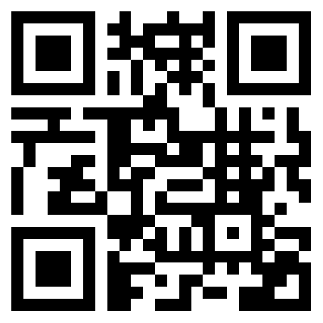
How are we doing?
Please take a minute to let us know
www.sba.gov/feedback

